Slide 1
NAPLAN
Topic: NAPLAN Recap
EQ: How do we work out ratios?
Mrs Stretch
Year 9

Slide 2
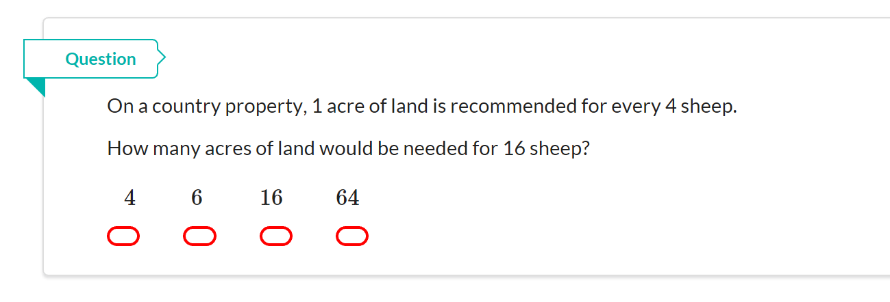
NAPLAN Question

Slide 3
24
7
30
Intro to Ratios
Date
EQ – What is a ratio and how is it used?
What is a ratio?
Ratios are used to compare quantities with the same units.
The ratio of 2 to 5 is written as 2 : 5
If you are making cordial and you mix one part cordial to four parts water, then the ratio of cordial to water will be 1:4 (1 to 4).
If you use 1L of cordial, you will use 4L of water (1:4).
If you use 2L of cordial, you will use 8L of water (2:8).
If you use 10L of cordial, you will use 40L of water (10:40).
How is a ratio used?
What are equivalent ratios?
These ratios are all equivalent 1:4 = 2:8 = 10:40

Slide 4
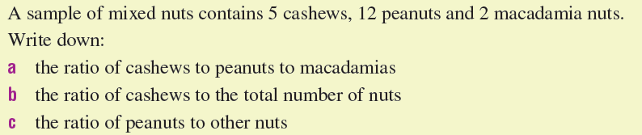
Example

Slide 5
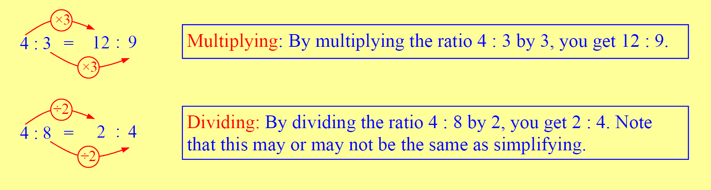
From Last Lesson

Slide 6
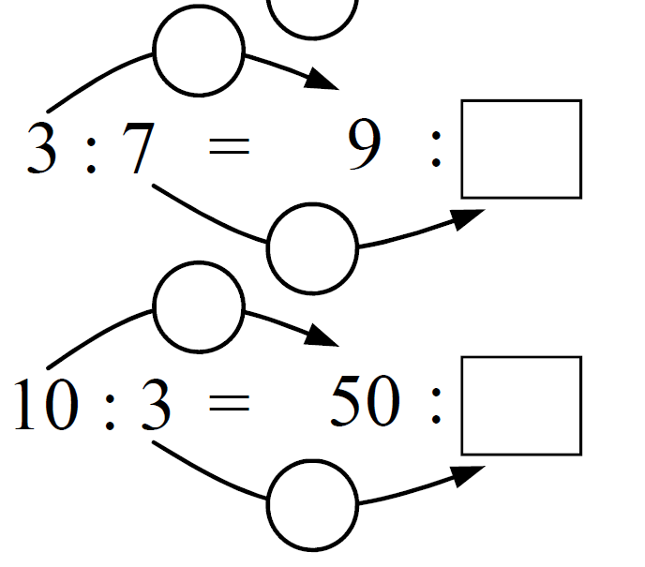
From Last Lesson

Slide 7
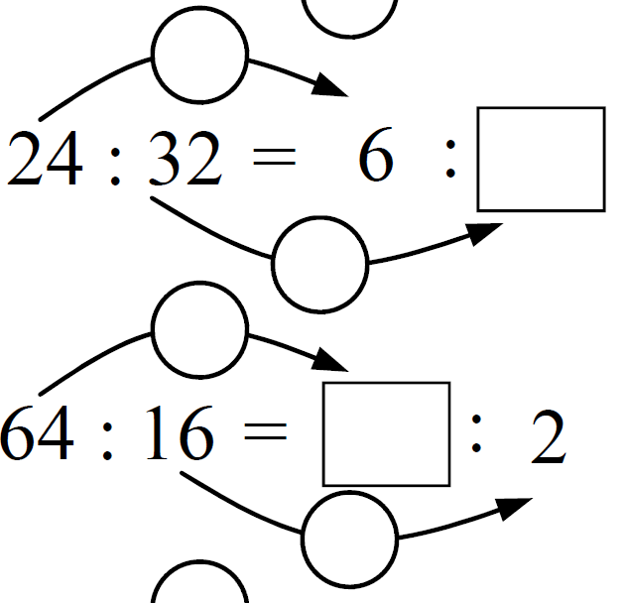
From Last Lesson

Slide 8
From Last Lesson

Slide 9
24
7
30
Simplifying Ratios
Date
EQ – How do you simplify ratios?
What does simplifying ratios look like?
Firstly simplify means to make something less complex or complicated. In other words to make the numbers smaller.
The trick with simplifying ratios is to always multiply or divide the numbers by the same number.
21 : 42
$÷7 ÷$7
3 : 6
1 : 2
We have simplified as much as we can.
$$÷3 ÷3$$

Slide 10
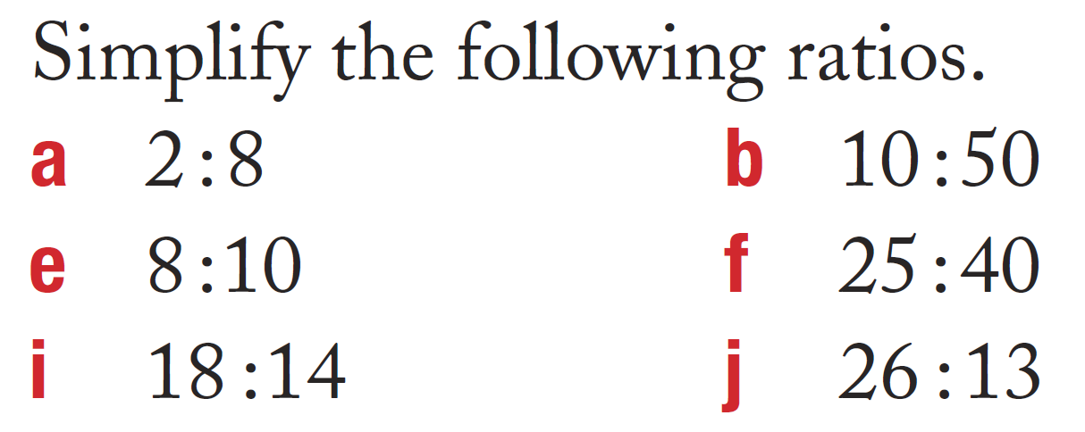
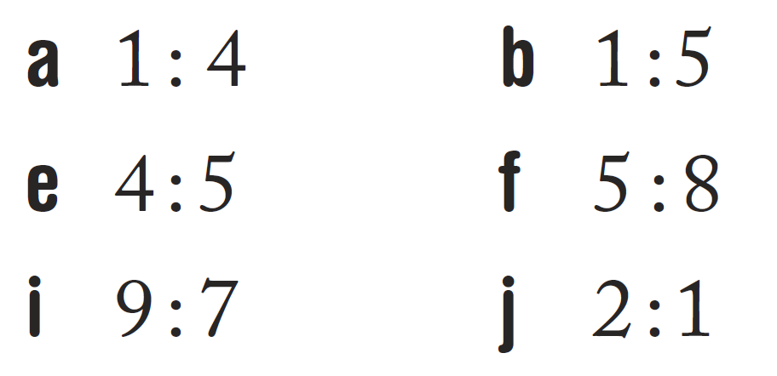
Task

Slide 11
Ratio Applications EQ: How do I divide a quantity in a given ratio?
Ratios are used in many different places. Some examples include:
Mixing cement
Baking
Medicine
Think of a ratio in terms of parts. A ratio of 2 : 3 has a total of 5 parts.
Use the following procedure:
Find the total number of parts in the ratio.
Find the value of one part.
Find the valve of the number of parts.
This is know as the unitary method.

Slide 12
The ice-cream problem
Mr Evans, Mr Morgan, Ms L and Ms D’Souza all invest money to start an ice-cream business.
They invest the following $120 : $200 : $80 : $300 (Just remember the ratio is in the same order as the people)
The ice-cream business produced a profit of $16,800.
How much should each person get based on their starting investment?
Step 1: I add all the parts together 120 + 200 + 80 + 300 = 700

Slide 13
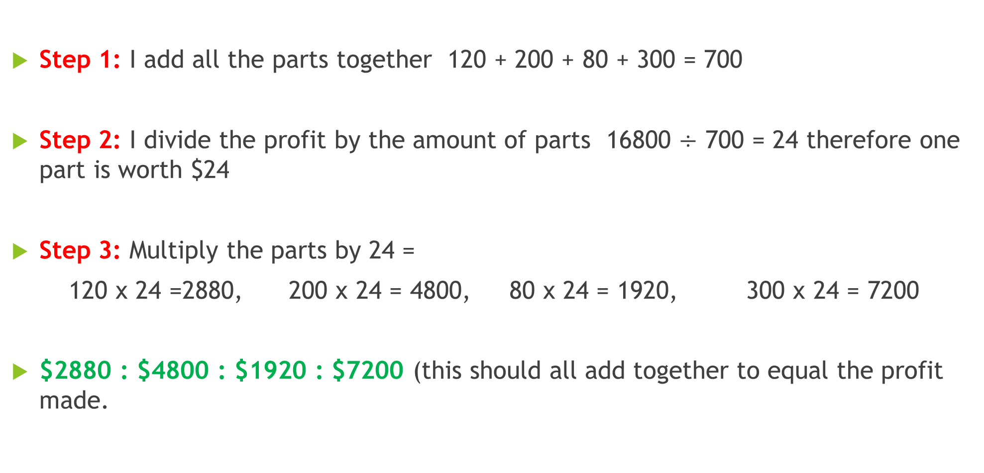


The ice-cream problem
Step 1: I add all the parts together 120 + 200 + 80 + 300 = 700
Step 2: I divide the profit by the amount of parts 16800 $÷$ 700 = 24 therefore one part is worth $24
Step 3: Multiply the parts by 24 =
120 x 24 =2880, 200 x 24 = 4800, 80 x 24 = 1920, 300 x 24 = 7200
$2880 : $4800 : $1920 : $7200 (this should all add together to equal the profit made.

Slide 14
The lottery problem
Mr Wilson, Mrs Keen and Mr Craig buy a lottery ticket. They put in different amounts of money to purchase the ticket as seen in the ratio $5 : $8 : $2. They won $7,500,000. How much do they get each?

